Slide 1
The language riddle, AI and safety offshore Jennifer Sampson Principal Data Scientist

Slide 2
The digital energy company​
Make data available anytime, anywhere
Always safe
High value
Low carbon
Predicting and preventing safety and security incidents
Robotics will make our work easier
Connecting minds and technology to become an industry leader

Slide 3
Predicting and preventing safety and security incidents
We apply digital tools to keep our people and operations safe
By gathering and visualizing relevant data, we provide all the information needed to make the best safety decisions.
Our digital tools also help us stay one step ahead of security threats and eliminate harmful attacks on our business.
Operational planning is by nature complex. Overall performance of the installations, activities, weather, maintenance and manning are just a few of the factors the platform managers have to consider. Our operational planning tool is a live dashboard that provides them with all the information needed to plan for a safe operations day.

Slide 4
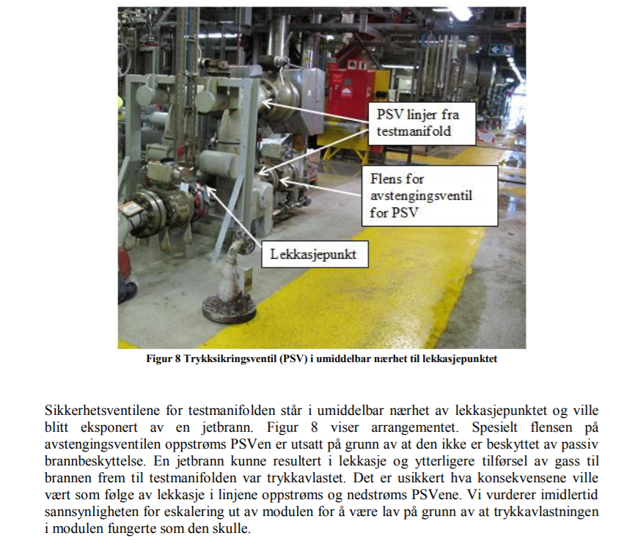
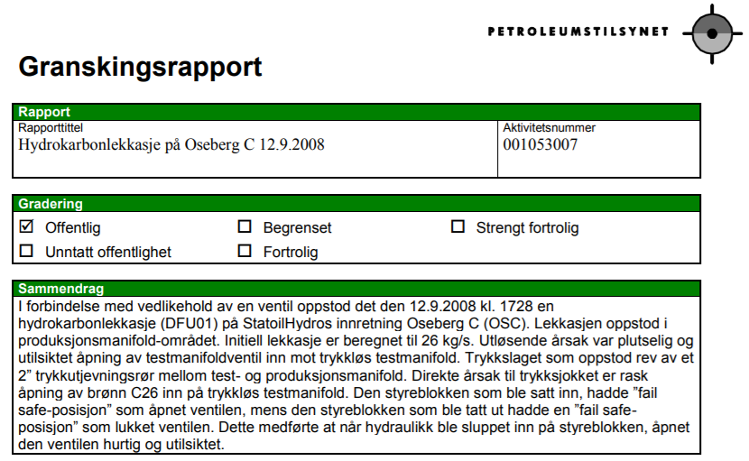
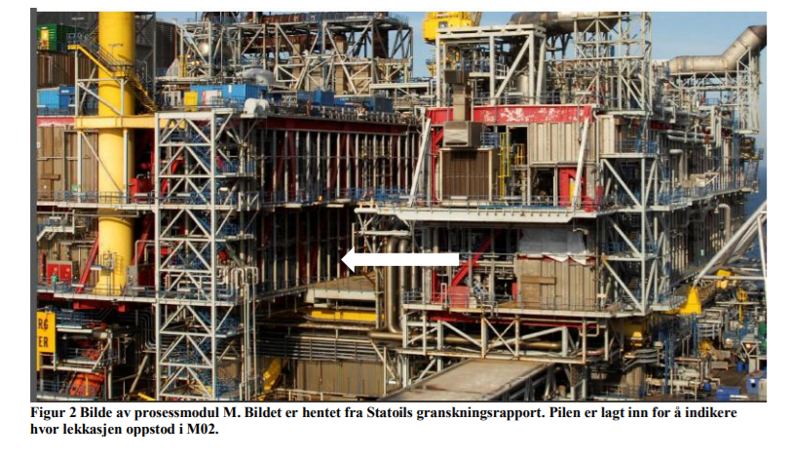
Knowledge AI challenge:
Can we use historical incident data to inform operations and prevent harm?
Avoid making the same mistakes and recommend non-intuitive actions. Is this possible?

Slide 5
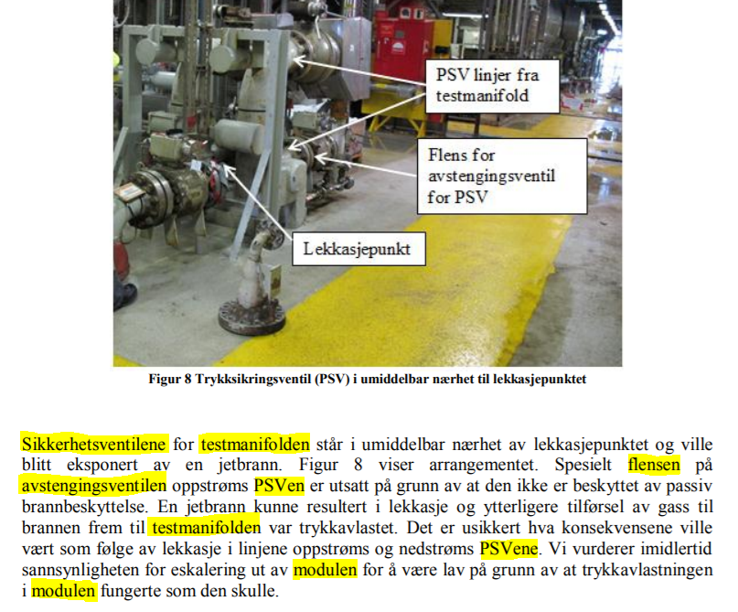
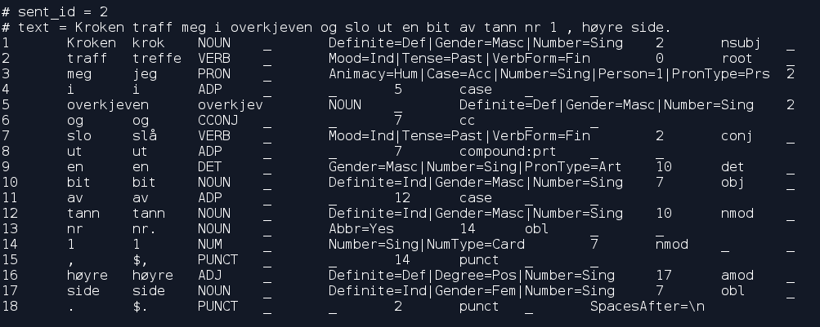
Norwegian Language
Structured & unstructured data alignment
Patterns
Entity extraction
Annotation tool
Equipment
Task
Objective
ML model for entity extraction
Word embeddings created using investigation reports
POS tagging

Slide 6
Knowledge Graph
18572 nodes (concept instances)
44426 edges (relationships between concepts)

Slide 7
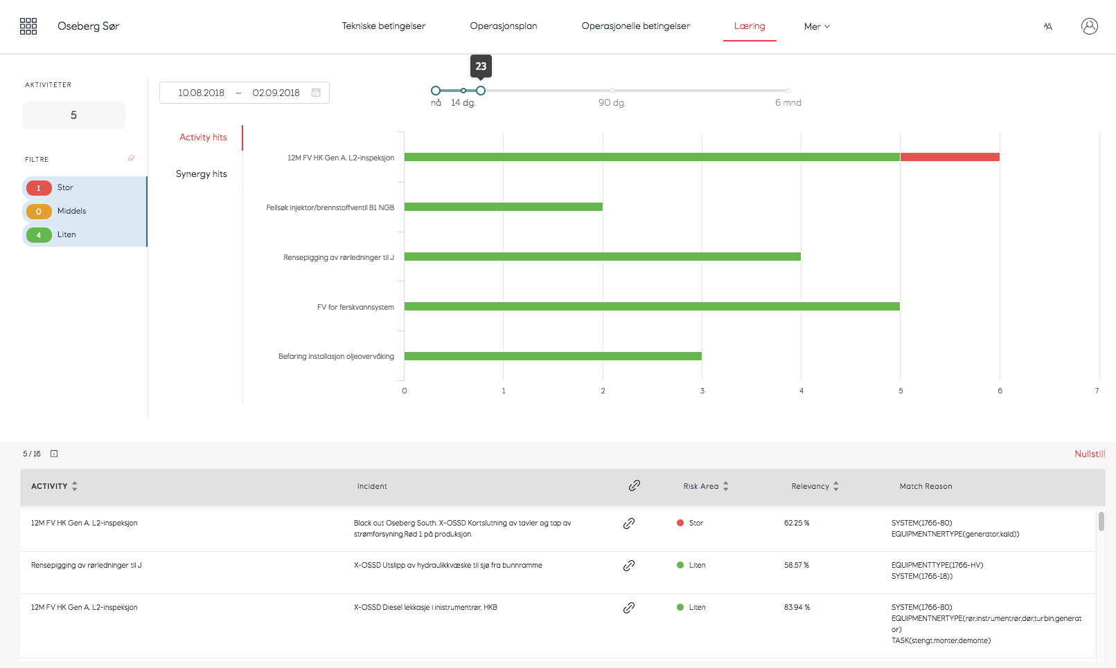
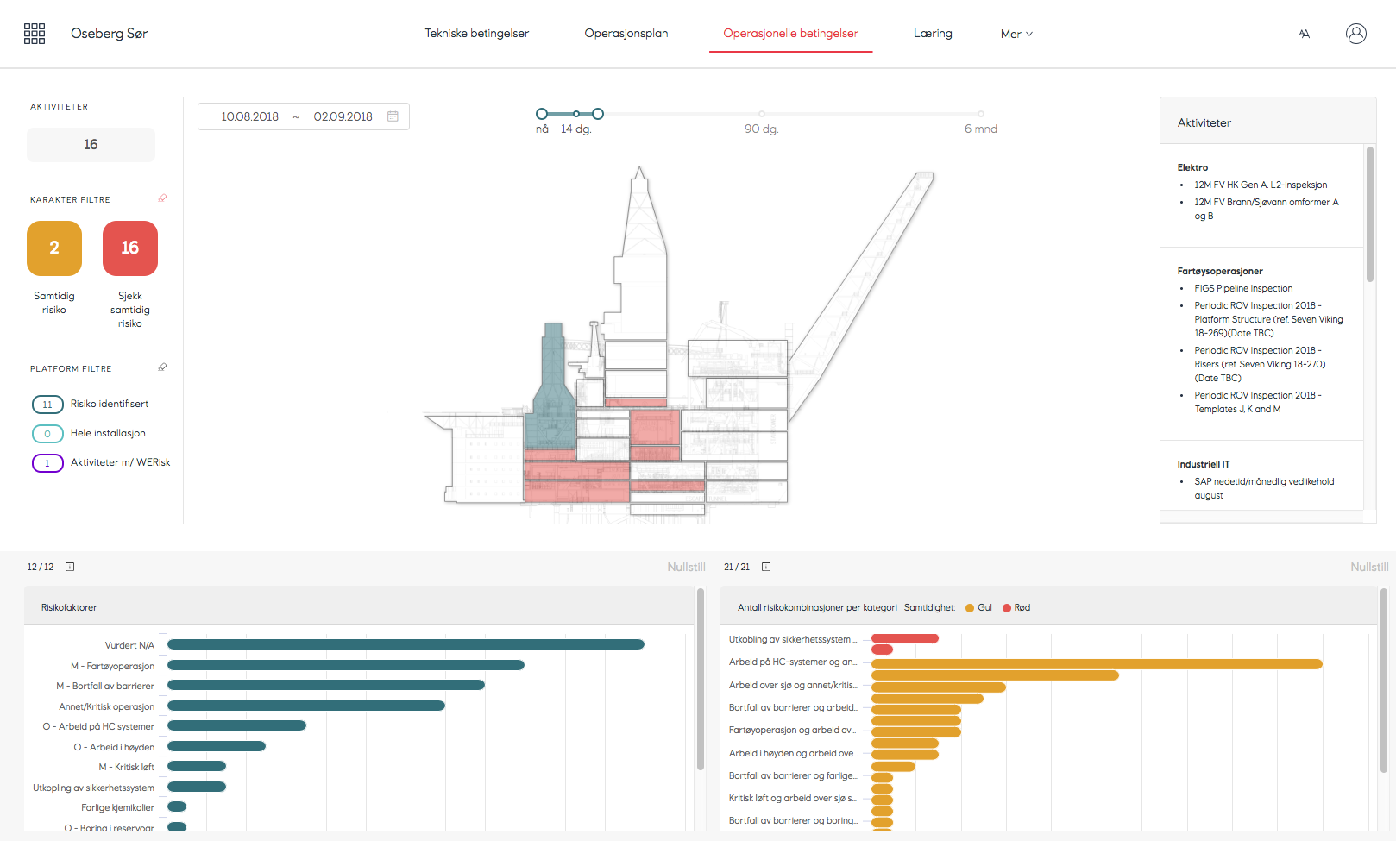
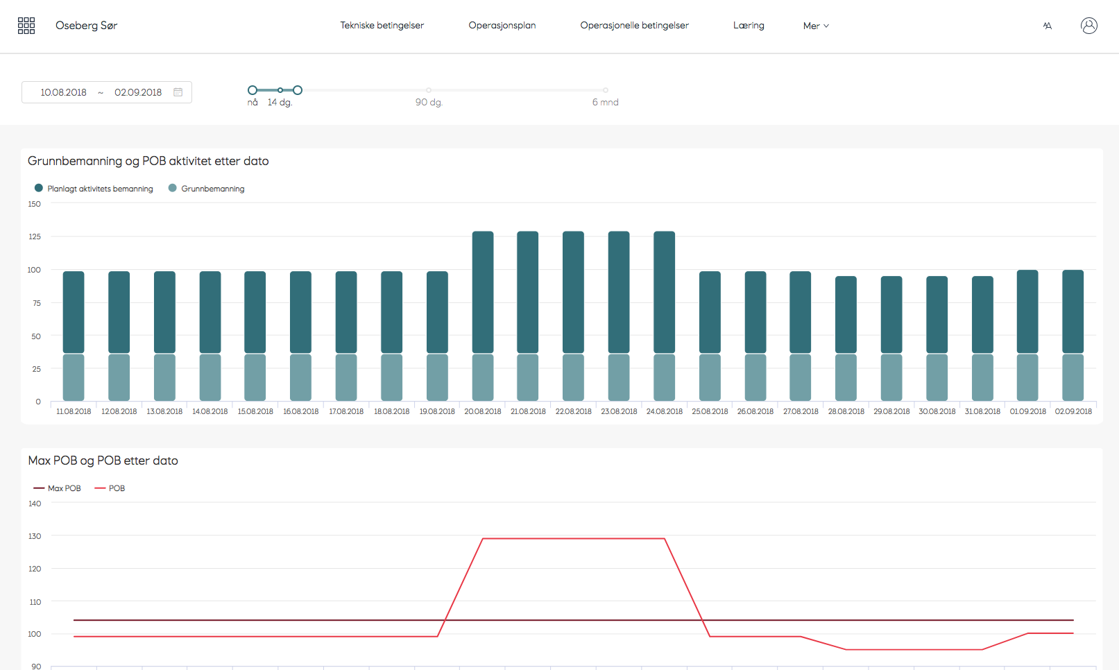

Slide 8
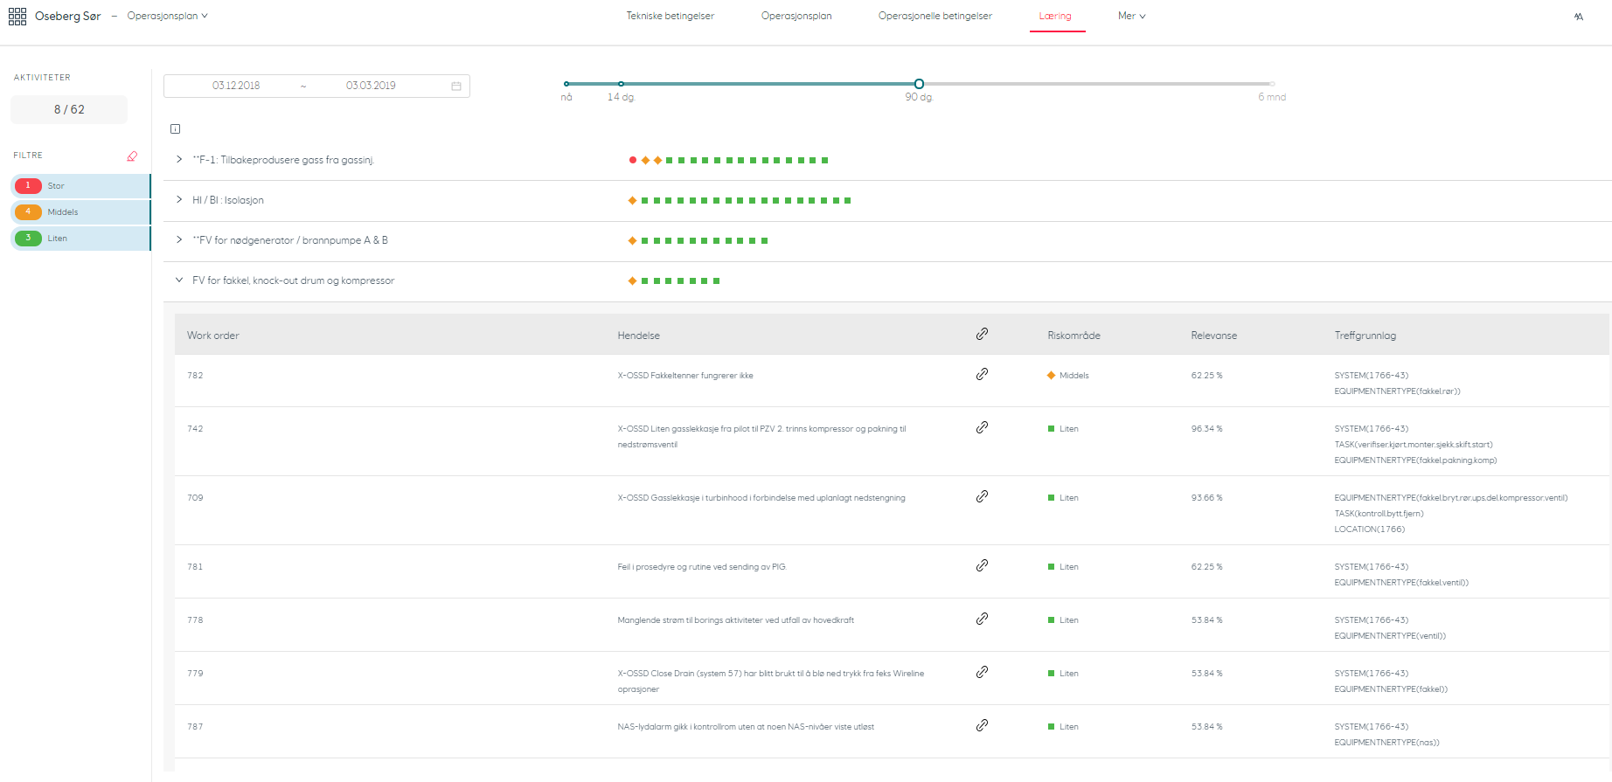

Slide 9
The language riddle, AI and safety offshore
Jennifer Sampson
Principal Data Scientist
COO DIG DS Knowledge AI

